Slide 1
CZ2001 – ALGORITHMS – EXAMPLE CLASS 3
Group 2
Jason Lee
Jordan Kwong
Joshua Martin Tjahjadi
Kwek Ai Hui
Shantanu Kamath
Suyash Lakhotia

Slide 2
INTRODUCTION

Slide 3
Objective
To perform empirical comparison of time efficiency between the two sorting algorithms:
Quicksort & Mergesort
INTRODUCTION • IMPLEMENTATION • STATISTICS • CONCLUSION

Slide 4
IMPLEMENTATION
Quick Sort
INTRODUCTION • IMPLEMENTATION • STATISTICS • CONCLUSION

Slide 5
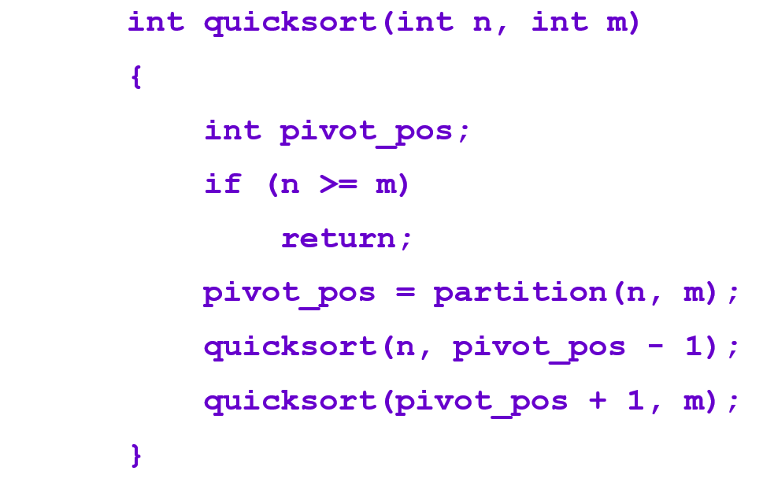
QUICK SORT
Quick sort is the fastest general in-memory sorting algorithm in the average case
how it is done:
It is done by using a pivot and partitioning list recursively
algorithm:
INTRODUCTION • IMPLEMENTATION • STATISTICS • CONCLUSION

Slide 6
Merge Sort

Slide 7
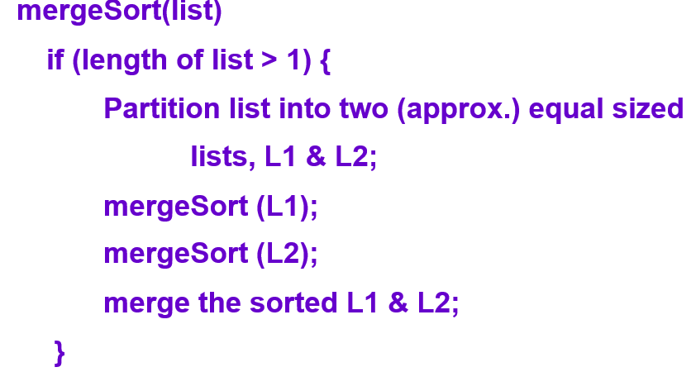
MERGE SORT
Merge sort is the most consistent in the best, average and worst case
how it is done:
It is done by swapping, shifting and merging of sub arrays
algorithm:
INTRODUCTION • IMPLEMENTATION • STATISTICS • CONCLUSION

Slide 8
DEMO
INTRODUCTION • IMPLEMENTATION • STATISTICS • CONCLUSION

Slide 9
STATISTICS

Slide 10
STATISTICS
Quick Sort
Data Size | Random |  | Ascending |  | Descending
 | Number of Comparisons | Average CPU time (nanoseconds) | Number of Comparisons | Average CPU time (nanoseconds) | Number of Comparisons | Average CPU time (nanoseconds)
2000 | 22318 | 378081 | 18987 | 55614 | 17996 | 49077
4000 | 45417 | 459641 | 41964 | 116412 | 39974 | 104481
6000 | 72357 | 1087225 | 67774 | 144127 | 64786 | 144561
8000 | 103137 | 1417685 | 91917 | 183970 | 87928 | 151235
10000 | 141142 | 2243798 | 119535 | 237417 | 114548 | 167315
INTRODUCTION • IMPLEMENTATION • STATISTICS • CONCLUSION

Slide 11
STATISTICS
Merge Sort
Data Size | Random |  | Ascending |  | Descending
 | Number of Comparisons | Average CPU time (nanoseconds) | Number of Comparisons | Average CPU time (nanoseconds) | Number of Comparisons | Average CPU time (nanoseconds)
2000 | 1673 | 7868894 | 1000 | 31972 | 1000 | 1478697
4000 | 3342 | 14932111 | 2000 | 125412 | 2000 | 3121683
6000 | 4999 | 16726038 | 3000 | 107380 | 3000 | 8376899
8000 | 6687 | 22300891 | 4000 | 233410 | 4000 | 12138751
10000 | 8384 | 12682896 | 5000 | 183092 | 5000 | 18963273
INTRODUCTION • IMPLEMENTATION • STATISTICS • CONCLUSION

Slide 12
STATISTICS - MergeSort
INTRODUCTION • IMPLEMENTATION • STATISTICS • CONCLUSION

Slide 13
STATISTICS - MergeSort
INTRODUCTION • IMPLEMENTATION • STATISTICS • CONCLUSION

Slide 14
STATISTICS - QuickSort
INTRODUCTION • IMPLEMENTATION • STATISTICS • CONCLUSION

Slide 15
STATISTICS - QuickSort
INTRODUCTION • IMPLEMENTATION • STATISTICS • CONCLUSION

Slide 16
CONCLUSION

Slide 17
CONCLUSION
Time complexity for both Merge Sort and Quick Sort is O(n log(n)) on average case scenario.
Number of key comparisons for quick sort is larger than merge sort. Despite that fact, the running time for quick sort is much smaller compared to merge sort.
Therefore, we can conclude that quick sort is better than merge sort in terms of running time with large datasets.
INTRODUCTION • IMPLEMENTATION • STATISTICS • CONCLUSION

